Slide 1
SECURE DATA HIDING IN IMAGES USING STEGANOGRAPHY
CAPSTONE PROJECT
Presented By: SHASWATA SAHA
Student Name : SHASWATA SAHA
College Name & Department : UNIVERSITY OF CALCUTTA (B.Tech CSE)

Slide 2
OUTLINE
Problem Statement
Technology used
Wow factor
End users
Result
Conclusion
Git-hub Link
Future scope

Slide 3
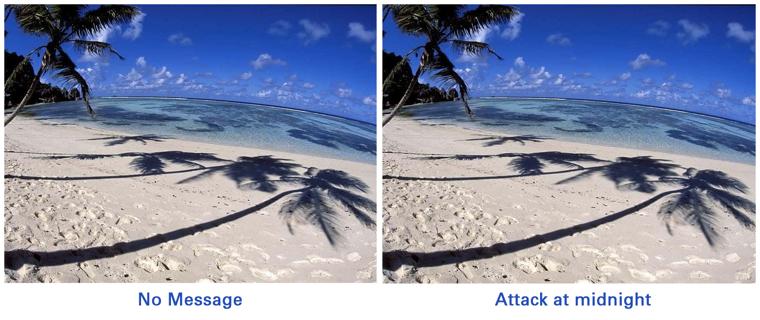
Problem Statement
Developing a Secure Data Hiding in Images using Steganography application using Python,
OpenCV, and Tkinter. The app will allow users to encode and decode files within images securely.
It will feature an intuitive GUI for selecting images, embedding files with a password, and retrieving hidden data.
Encryption enhances security, ensuring safe and efficient data hiding.
NORMAL IMAGE
IMAGE WITH SECRET

Slide 4




Technology used
I developed a Secure Data Hiding in Images using Steganography using Python with the following
technologies:
Tkinter: Built the GUI for a user-friendly interface to encode and decode hidden data in images.
Pillow (PIL): Handled image processing tasks such as loading, modifying, and saving images efficiently.
Stegano: Provided steganographic encoding and decoding functionalities for secure data embedding.
NumPy: Assisted in efficient numerical operations and pixel manipulation for image processing.
OpenCV (cv2): Enabled advanced image handling, transformations, and visualization.
This application allows users to securely embed and retrieve hidden files from images using password protection,
ensuring a simple yet effective steganography implementation.

Slide 5
Wow factors
1. Dual Interface (CLI + GUI) Support
Offers both command-line (CLI) and graphical user interface (GUI) versions for accessibility.
CLI provides lightweight, scriptable execution, while GUI ensures ease of use for non-technical users.
2. Password-Protected Encoding & Decoding
Ensures security and controlled access to hidden messages.
Users must provide the correct password to retrieve the embedded data.
3. Flexible Data Handling
Supports direct text input, embedding text files, and extracting messages into files, making it versatile.
4. Modular & Extensible Design
Separate Python scripts (cli_rgb_change_stego.py, gui_rgb_change_stego.py, gui_stego_lib.py) allow users to choose between different functionalities.
Easy to integrate or extend with additional cryptographic techniques if needed.
5. Interactive GUI for Seamless Experience
Built with Tkinter, providing an intuitive interface for encoding and decoding messages without requiring command-line knowledge.
6. Secure and Encrypted Storage
The project doesn't just embed messages; it also encrypts them within images, ensuring confidentiality and protection from unauthorized access.

Slide 6
End users
Cybersecurity Enthusiasts & Researchers
Can explore and analyze data hiding techniques using RGB value manipulation and LSB steganography.
Useful for studying secure communication and cryptographic applications.
Ethical Hackers & Digital Forensics Experts
Helps in understanding covert communication methods used in cybersecurity.
Can be used for analyzing hidden data within images for forensic investigations.
General Users Seeking Data Privacy
Individuals who want to securely store sensitive messages inside images for personal use.
Useful for private communication and secure storage of information without drawing attention.
Students & Educators in Computer Science
A great learning tool for students studying cryptography, cybersecurity, or digital image processing.
Educators can use this project to demonstrate steganography concepts practically.
Developers & Open-Source Contributors
Offers an extensible framework for developers to modify and enhance steganographic methods.
Open-source contributors can experiment with improving security measures and adding new features.
Government & Intelligence Agencies
Can be used for covert data transmission in secure environments.
Assists in research for counter-steganography techniques to detect hidden threats.

Slide 7
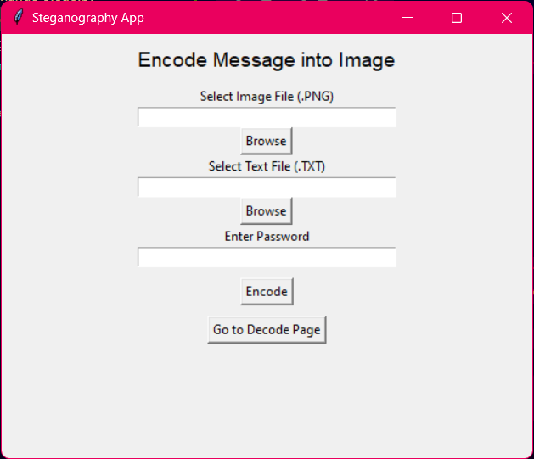



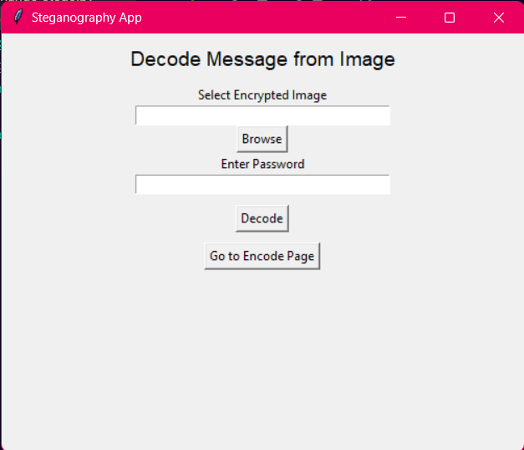
Results
Text: Hello there
Passphrase: 12345
ORIGINAL IMAGE
ENCRYPTED IMAGE
GUI OF APPLICATION

Slide 8
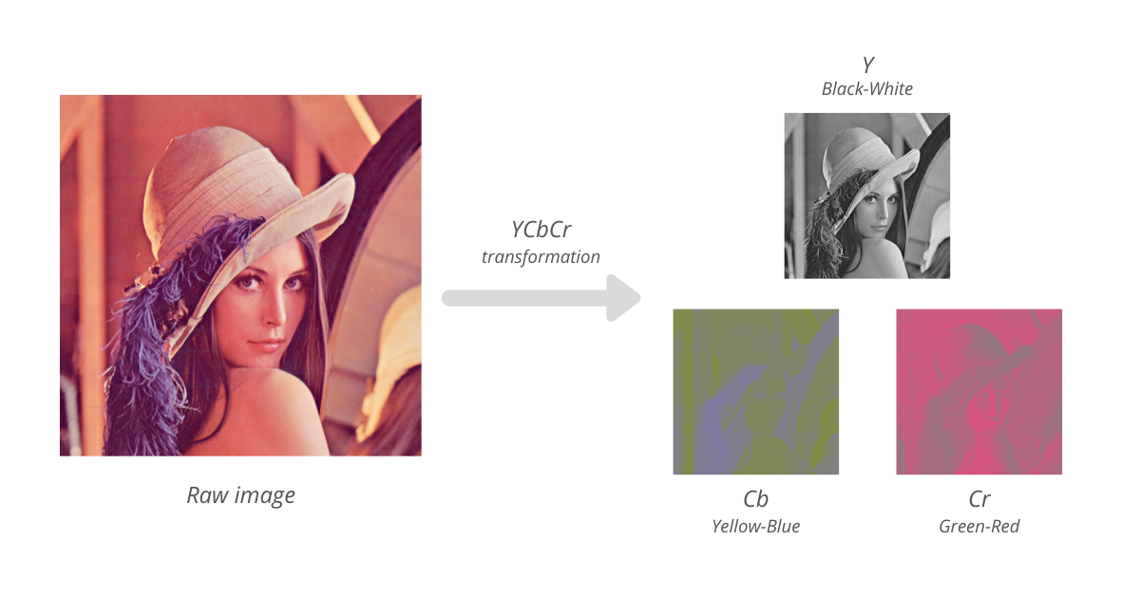
Conclusion
The AICTE Steganography Project is a powerful and versatile tool that combines security, usability, and flexibility in data hiding. By integrating RGB manipulation and LSB steganography, it provides a secure way to embed and retrieve hidden messages within images. With both CLI and GUI interfaces, it caters to a wide range of users—from cybersecurity professionals and ethical hackers to students, educators, and privacy-conscious individuals. The inclusion of password protection enhances security, ensuring that sensitive information remains confidential. This project not only serves as a practical application of steganography but also opens doors for future enhancements in secure communication and data protection.

Slide 9

GitHub Link
https://github.com/subhro1530/Steganography_GUI.git

Slide 10
Future scope
1. Enhanced Encryption Techniques
Implement AES or RSA encryption before embedding data to increase security.
Combine steganography with cryptography for multi-layered protection.
2. Support for Multiple File Types
Extend the system to hide various file formats (PDFs, audio, videos) instead of just text.
Introduce compression algorithms to optimize storage.
3. AI-Based Steganalysis Resistance
Integrate machine learning techniques to make hidden messages more resistant to detection.
Ensure robustness against modern steganalysis attacks used in cybersecurity.
4. Cross-Platform & Mobile Support
Develop Android/iOS applications for on-the-go secure data embedding and retrieval.
Build a web-based version for easy accessibility without local installations.
5. Blockchain Integration
Utilize blockchain technology for tracking and verifying steganographic files.
Enable a tamper-proof and decentralized steganography system for highly secure communications.
6. Cloud-Based Secure Storage
Implement a cloud-based service where encrypted steganographic images can be securely stored and accessed.
Enable secure file sharing with end-to-end protection.

Slide 11
THANK YOU
SHASWATA SAHA
shaswata.ssaha@gmail.com
https://www.linkedin.com/in/shaswata-saha-74b209251/

